Slide 1
Scale And Generalization

Slide 2
Scale
There are two types of scale:
Cartographic Scale
Geographic Scale

Slide 3
Cartographic Scale:
Definition of scale:
Different type of cartographic scale
Nominal scale
Representative fraction
Graphical scale

Slide 4
Geographic scale
Geographic scale: This refers to the size and scope of the study area.
Examples:
If you study poverty scenario in the Nepal you will come up with different conclusions than if you study poverty scenario in Lamjung district because the scale is different. In this case scale refers to both the size of the land area and the scope of the data and variables.
You want to look at a specific demographic. You have to choose how you want to look at them.
Global level: the entire population of world
National level: the entire demographic in a country
Regional level: the demographic in region
Local level: the demographic In a city or town
Each of these is a geographic scale, each provides a specific view and level of data and interrelationship.
Geographic scale is more of a concept, that things and phenomenon are looked at varying scales.

Slide 5
Map generalization
Map generalisation
Introduction
Conceptual and graphic generalization
Guidelines for map generalisation
General guidelines:
Detailed Guidelines: built-up areas
Map Generalisation process
Sequence of map generalisation activities
Interrelation of map generalisation activities

Slide 6
What is generalization?
The process of reducing the amount of detail in a map (or database) in a meaningful way.
Generalization related to the map purpose
Generalisation is scale related
Generalization is partly subjective
Generalization is output related

Slide 7
Why generalization ?
If a map is produced from a database ( or a map ) at a scale smaller than intended the map might become illegible.
The data ( map ) require generalization.

Slide 8
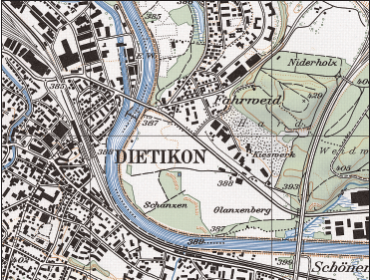
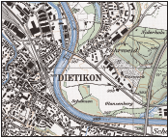

Scale reduction without generalisation
1:25000
1:25000
1:50000
1:100000

Slide 9
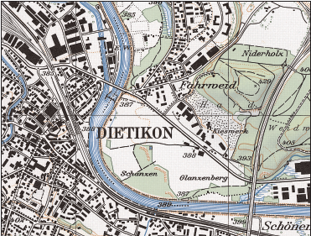
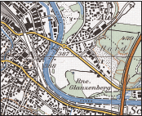

Scale reduction with generalisation
1:25000
1:50000
1:100000

Slide 10
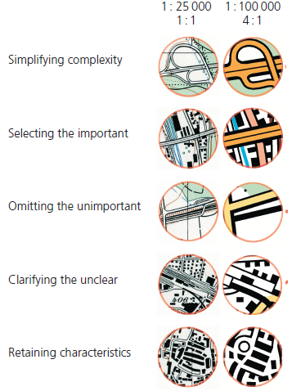

Slide 11
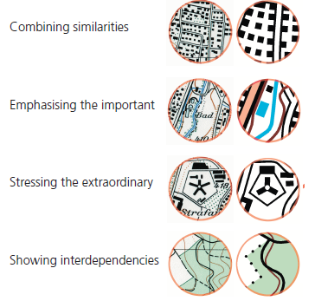

Slide 12
Why is generalisation necessary?
Increased density of the map contents due to scale reduction.
Features become too small to be seen clearly, or to be represented at true size (to scale) on a monitor or on paper.

Slide 13
Generalisation activities are scale related
On large scale maps the real world can be represented with large detail. Such maps require only little generalisation: some simplification, some enlargement or some displacement
of features.
However, the smaller the scale of the map, the less detail can be represented,
the more important
generalisation
becomes.

Slide 14
Generalizing activities are scale related
Where does generalisation really begin?
Scales ≥ 1:5,000: the planimetric accuracy of the original survey data are fairly well maintained.
Scales 1:10,000 – 1:25,000: some roads and other features (e.g. railways) are no longer true to scale.
Some simplification, enlargement or displacement of features.
Scales 1:25,000 – 1:50,000: roads and buildings are no longer true to scale (roads are represented by lines). Buildings are often simplified and displaced. In densely built-up areas buildings are already omitted or combined.

Slide 15
Generalizing activities are scale related
Scales ≤ 1:50.000:
Selection, reclassification and re-symbolization; Strong simplification and displacements;
Buildings no longer true to scale or not shown as individual buildings;
Merging of area features

Slide 16
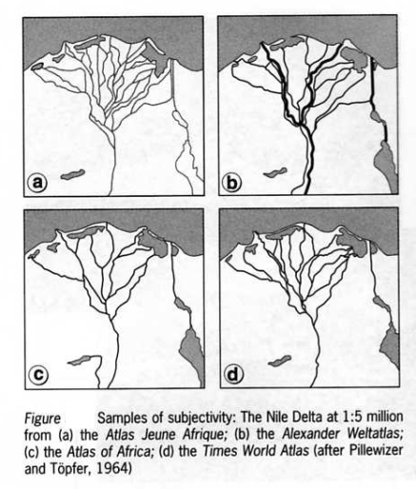
Generalization is partly subjective
Generalization result could differ from cartographer to cartographer.

Slide 17
Conceptual and graphic generalisation
Conceptual generalisation:
selection/omission of categories, (re)classification, (re)symbolisation or the enhancement of objects.
It mainly effects the semantics (attributes) of the data. The map legend changes.
Graphic generalisation:
simplification, enlargement, displacement, or the graphic combination or selection of objects.
It mainly effects the geometry and location of the objects.

Slide 18
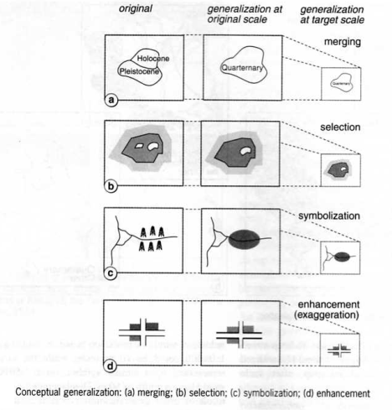
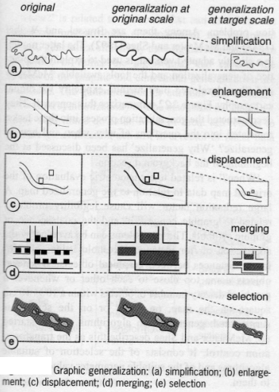
Conceptual & Graphic generalization

Slide 19

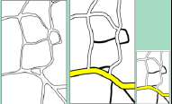

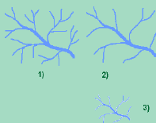
Match the following
Aggregation
(merging)
Classification
Emphasis
(enhancement)
Exaggeration
(enlargement)

Slide 20
Guidelines for map generalisation

Slide 21
General guidelines (I)
select those features that are necessary or useful for the purpose of the map and in accordance to the scale. Emphasize the most important features and omit or repress the less important ones;
have regard for the displacement priority rules;
have regard for the minimum sizes of graphic map symbols; within the limitations imposed by the map scale,
planimetric accuracy should be maintained.

Slide 22
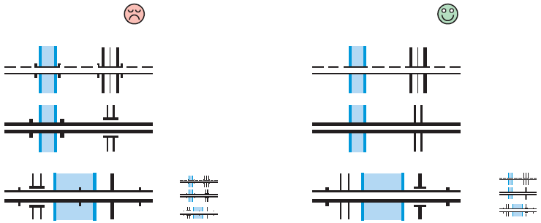
Important and less important features

Slide 23
Priority rules for the displacement
Trigonometric points
Hydrographic features
Railways
Roads
Buildings
Area features, e.g. forests
(The requirement to represent international boundaries accurately may override the above priorities)

Slide 24
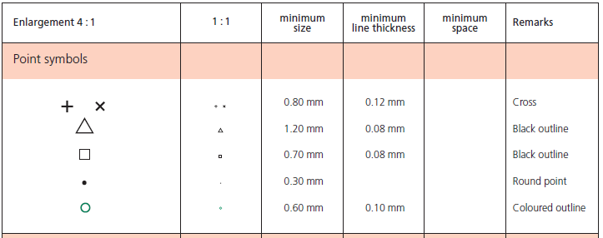
Minimum sizes of point symbols: white Paper (example)

Slide 25
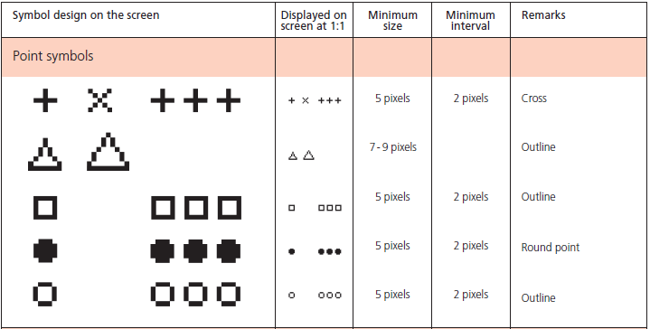
Minimum sizes of point symbols: screen (example)
(Pixel size of 0.3 mm is assumed).

Slide 26
General guidelines (II)
retain important and noticeable features. For example isolated buildings in a rural area will often be retained on medium scale maps because of their importance in the area;
within the limitations imposed by the map scale, shape of features and the character of the area should be maintained. For example if an area is characterized by numerous small rivers and lakes and forest areas, this should also be clear at smaller scales;

Slide 27
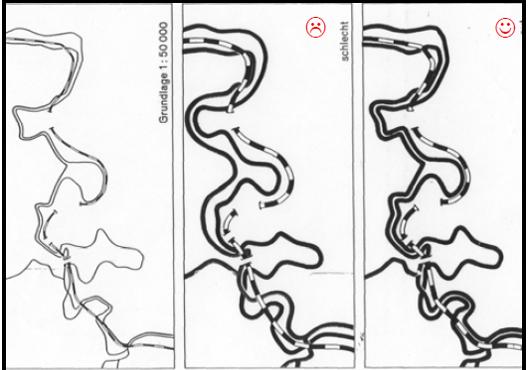

Slide 28
General guidelines (III)
relationships between features should be taken into account. For example there is a close relationship between relief (e.g. contours) and hydrography. After generalisation the contours should still fit to the river system. The size of buildings in built-up areas should be in relation to open areas and the width of streets.
be consistent

Slide 29

Change of symbol typification
at large scales, individual buildings.
at smaller scales, built-up area symbol for the larger urban areas.
at very small scales, (small) settlements shown by point symbols.

Slide 30
Generalisation: built-up areas
points to watch in graphic representation
Minimum dimension and distances
Shapes
Special buildings
Maintain structure: density, size differences, orientation, characteristic shapes
Displacement of buildings along roads
Maintain relative location

Slide 31
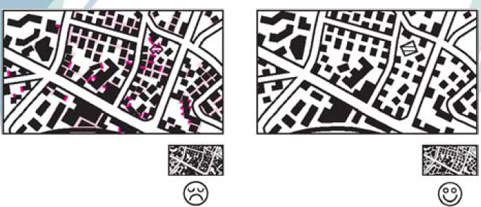
Minimum dimension and distances

Slide 32
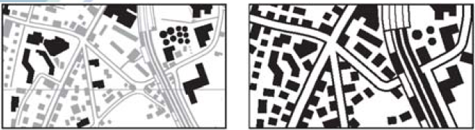
Structure: characteristic shapes

Slide 33
Sequence of map generalization activities
Conceptual generalisation:
Conceptual selection: extraction of purpose and scale adapted objects or group of objects based on database attributes.
Reclassification: reclassify objects into another category to enable aggregation with objects having the same class.
Re-symbolisation: geometry type change (includes collapses a polygon either to a line or to a point)

Slide 34
Graphic generalisation:
Aggregation: combine objects of the same or a similar class to a new object
Exaggeration: enlarges objects
Displacement: displace objects in conflict situations
Deletion: removes an objects
Simplification: form of the lines and area outline

Slide 35
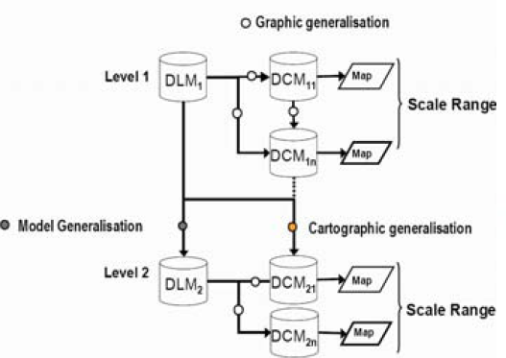
Example: generalisation flow

Slide 36
Thank You

